Slide 1

SALES PATTERN ANALYSIS AND OPERATIONAL BOTTLENECKS IN A DINE-IN RESTAURANT USING POS DATA
SUBMITTED BY: NAME : VAIBHAV SONI
STUDENT EMAIL: 23F2004675@DS.STUDY.IITM.AC.IN
ROLL NUMBER: 23F2004675

Slide 2
CONTENT
About the business
Challenges
Online vs. Offline orders
Order trend overview
Orders with Hours
Top 15 most ordered items with sales
Results and Recommendations

Slide 3
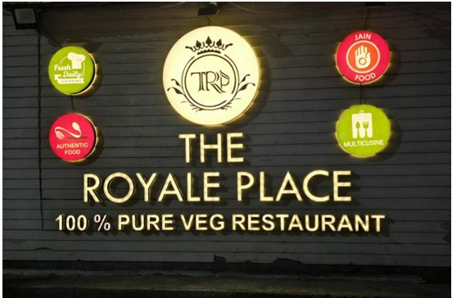
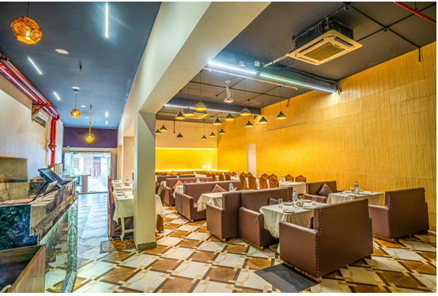
ABOUT THE BUSINESS
The Royale Place is a vegetarian multi cuisine restaurant located in Bhawanipur, Kolkata, West Bengal.
It offers a wide variety of dishes with a special focus on Jain dietary requirements and fresh daily catering.
The restaurant operates in the B2C food & beverage sector and has built a strong, loyal dine-in customer base.

Slide 4

CHALLENGES
Limited visibility into sales patterns
Low online sales

Slide 5
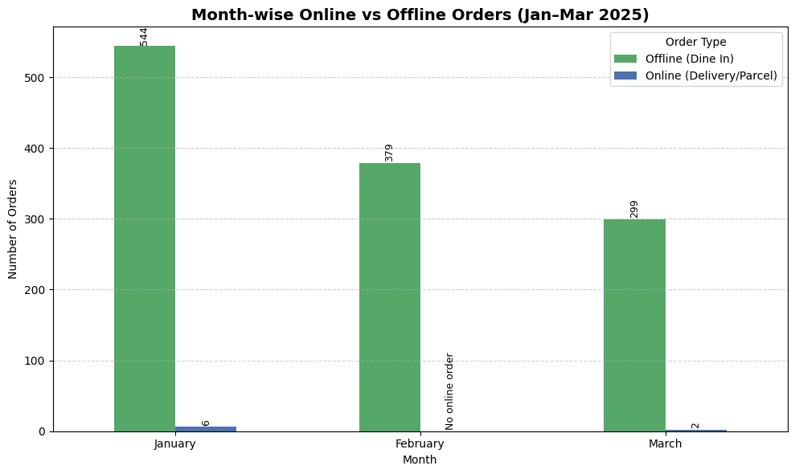
ONLINE VS. OFFLINE ORDERS
January 2025
  Offline orders: 544
  Online orders: 6
February 2025
  Offline orders: 379
  Online orders: 0
March 2025
  Offline orders: 299
  Online orders: 0

Slide 6
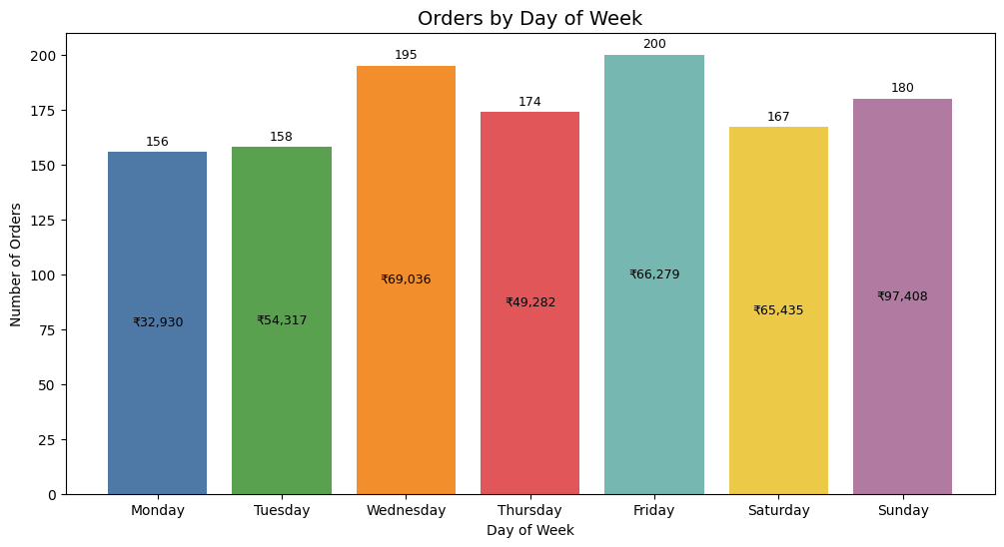
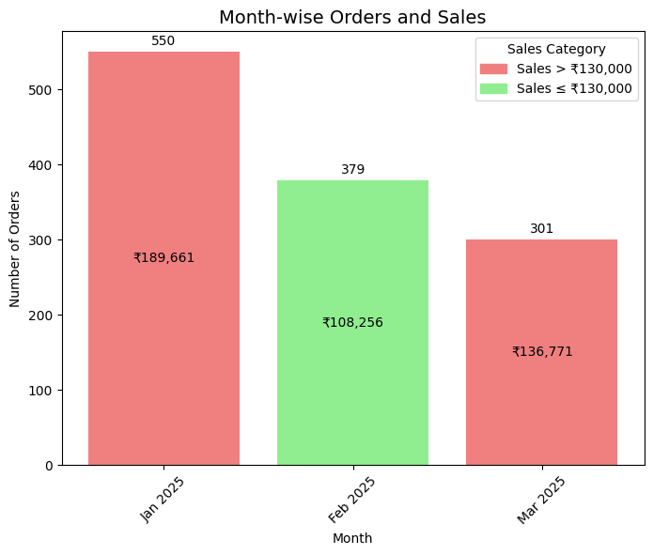
Order trend overview
→ Friday: 200 orders, ₹66,279 sales
→ Sunday: 180 orders, ₹97,408 sales
→ Jan 2025: 550 Orders, 1,89,661 rupees sales
→ Monday: 156 orders, ₹32,930 sales
→ Feb 2025: 379 Orders, 1,08,256 rupees sales
→ Mar 2025: 301 Orders, 1,36,771 rupees sales

Slide 7
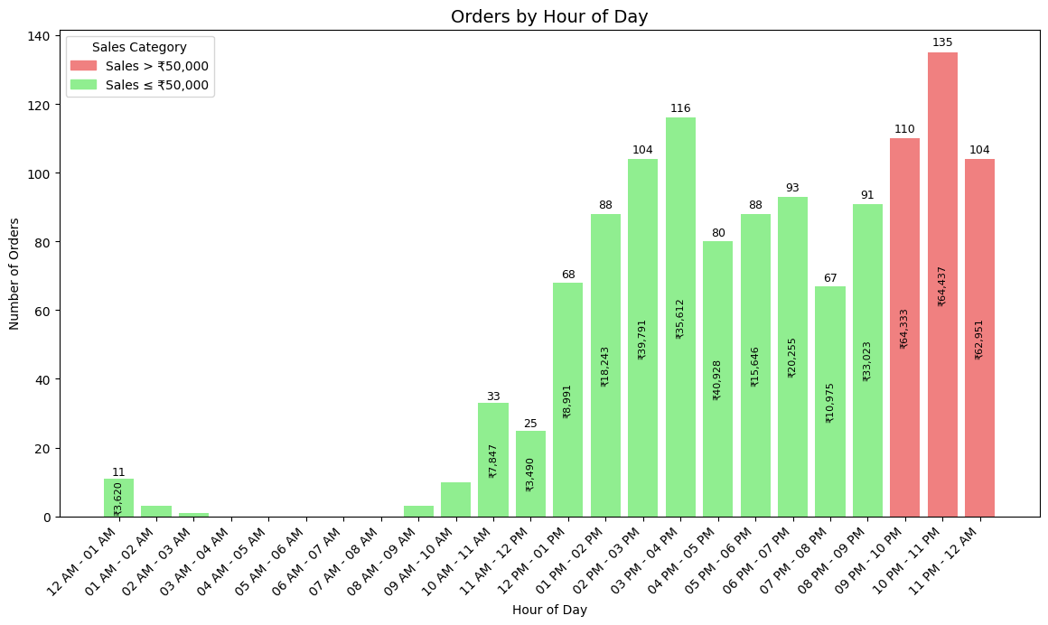
Orders with Hours
10 PM – 11 PM
135 orders
₹64,437 Sales
11 PM – 12 AM
104 orders
₹62,951 Sales
09 PM – 10 PM
114 orders
₹64,333 Sales

Slide 8
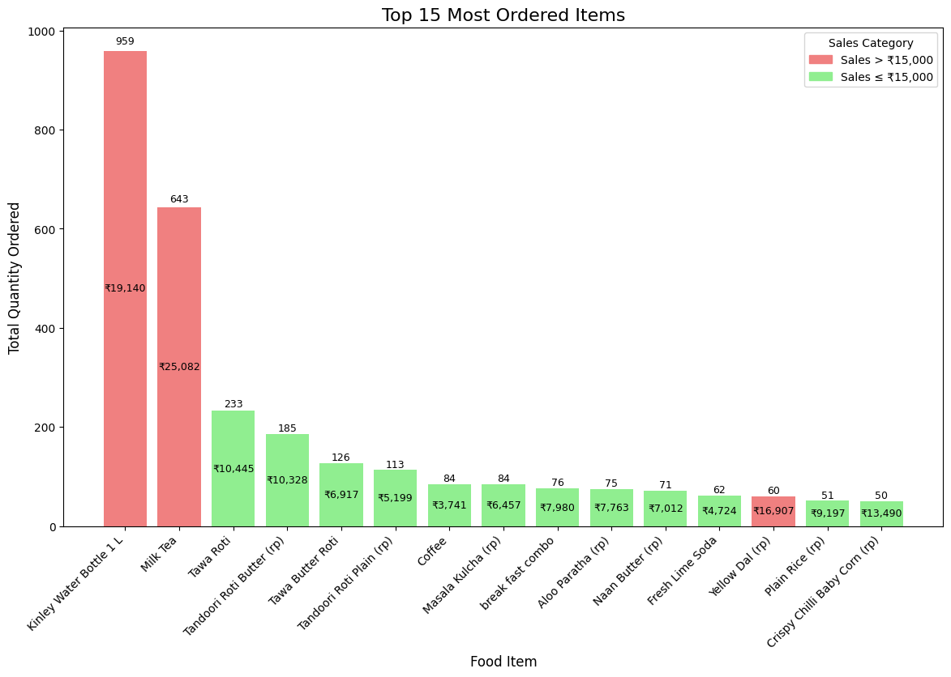
Top 15 most ordered items with sales
Kinley Water Bottle: 959 units
Milk Tea: 643 units
Tawa Roti: 233 units
Tandoori Roti Butter: 185 units
Tawa Butter Roti: 126 units
Yellow Dal: 60 portions, ₹16,907

Slide 9
RESULTS AND RECOMMENDATIONS
Results
Recommendations
01
Dine-In Dominance and Negligible Online Orders
01
Integrate with Major Online Delivery Platforms (Swiggy & Zomato)
02
Strong Weekend Traffic and Late Night Peaks
02
Use Influencer Marketing to Increase Visibility
03
Monthly Revenue Trends (Jan best)
03
Promote High-Margin Menu Combinations
04
Menu Consumption Patterns
04
Improve Digital Content and Customer Engagement

Slide 10
THANK YOU

